Slide 1
Images & Backgrounds
08
I399 Web Development

Slide 2
Images

Slide 3
REVIEW: Content Images <img>
<img src="images/kittens.png" alt="kitten">
<img src="images/kittens.png" /> (HTML4)
<img src="images/kittens.png"
alt="kitten"
srcset="kitten-HD.png 2x">
The src attribute works just like href does for the <a> anchor link tag. Specifying the width and height is sometimes done here, sometimes in the CSS.

Slide 4
Vector versus Raster
Vector
Image made up of dots and lines with given coordinates
Best for logos and graphical elements with big areas of a single color
Completely resizable
Adobe Illustrator creates vector graphics
Raster
Image made up of pixels, each with their own color
Best for photographs
Resizing possible, but can't make an image larger without losing quality
Adobe Photoshop creates raster graphics

Slide 5


Web Image Formats: GIF
Images ending with .gif are excellent for:
Logos/graphics with large swaths of the same color
A simple graphic where you need one color to disappear / be transparent
If you want an animated gif

Slide 6
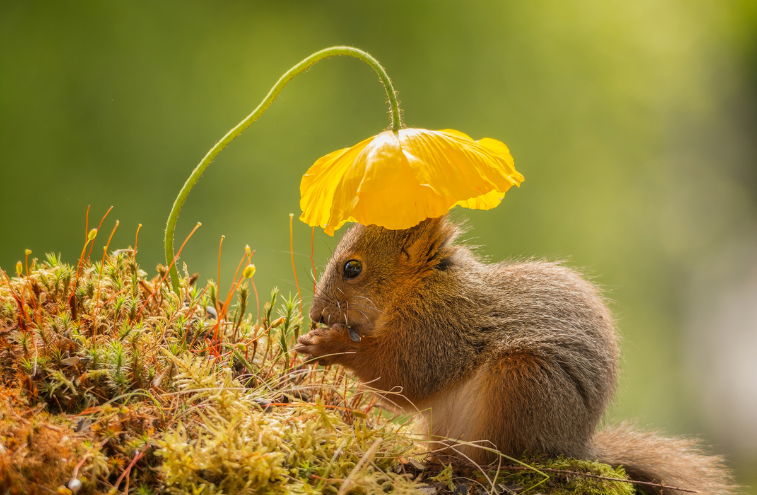
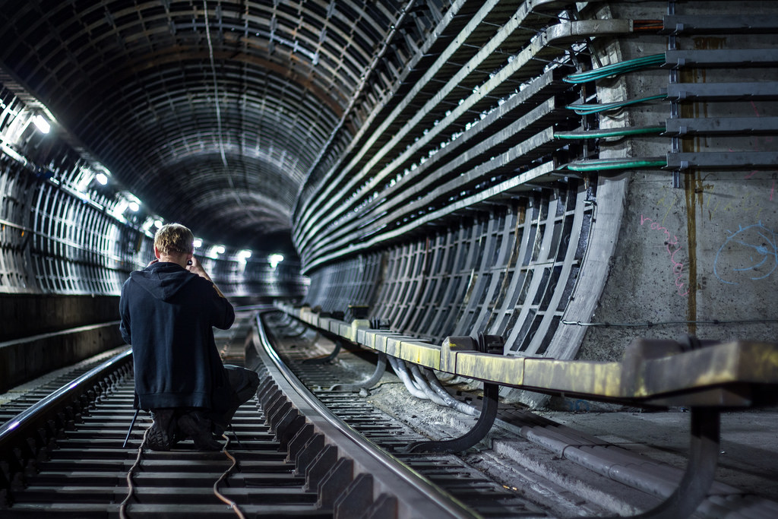
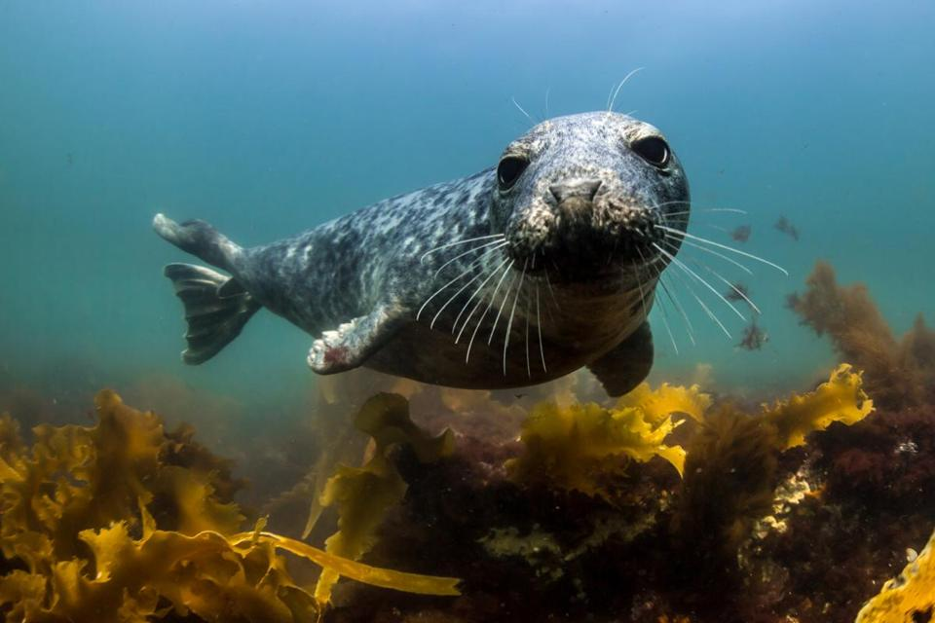
Web Image Formats: JPG
Images ending with .jpg are best for:
Photographs
Complex images where no transparency is needed

Slide 7
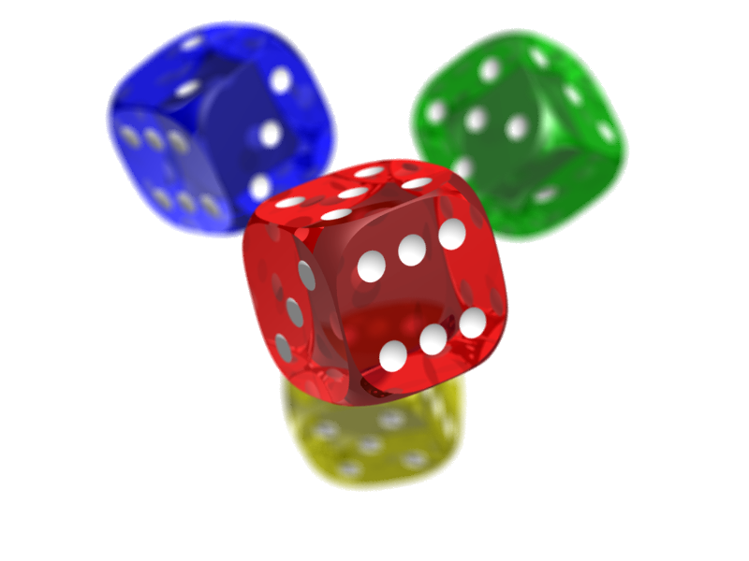
Web Image Formats: PNG
Images ending with .png are just perfect for:
simple graphics when transparency is needed - in fact, PNG-8 is now considered better than GIF for these
when the transparency is complex or there is a lot of blending of colors, use PNG-24, but know that the file size will be larger

Slide 8


Web Image Formats: SVG
Scalable Vector Graphic
Written in code within <tags>
Can be made interactive
Drawn by the browser = no resource to load
Most browsers will draw, but not widely adopted yet

Slide 9
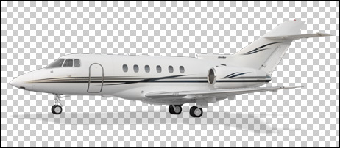
Transparency: the alpha channel
A "fourth" dimension to each pixel. We know about red, green and blue mixing together to make a color. The "alpha channel" or the "a" in rgba is a number from 0 to 1, where 0 is transparent and 1 is opaque.
rgb(80, 80, 255) = a blue color
rgba(80, 80, 255, 1) = same blue color
rgba(80, 80, 255, 0) = invisible/transparent
rgba(80, 80, 255, 0.5) = 50% transparent version of same blue color

Slide 10
Resolution!
When it comes to graphics, the resolution required for an image to appear beautifully on a screen is not necessarily the same as what is required for print.
Images on websites should be OPTIMIZED (made to fit the resolution and size needed) so that loading time is reduced.
OMG! SO, WHAT HAPPENS WHEN YOU PRINT A GRAPHIC THAT IS OPTIMIZED FOR VIEWING ONLINE?

Slide 11
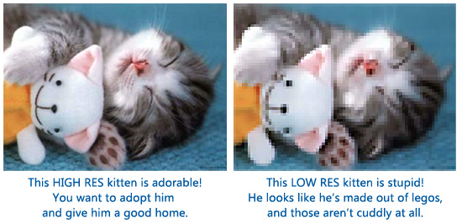
Resolution!

Slide 12
Resolution!
The point….
If you’re working with a brand, you’ll need graphics optimized for printing purposes, and some optimized for digital usage.
And because of the rise in HD and “retina displays” (better monitors), we may need several versions at different sizes for digital usage as well.

Slide 13
Backgrounds

Slide 14
CSS backgrounds
body {
background-color: green;
background-image: url('baby-goat.png');
background-repeat: no-repeat;
background-attachment: fixed;
background-position: right top;
}

Slide 15
Shorthand property
body { background: #ffffff url('tree.png') no-repeat right top; }
The order of the property values is:
background-color
background-image
background-repeat
background-attachment
background-position
Not all property values required as long as the ones that are present are in this order. More values exist, but we usually don’t need to set them.. They can stay as defaults.
https://developer.mozilla.org/en-US/docs/Web/CSS/background

Slide 16
Important parts:
If my image is large, and I don't want users to scroll off of it, I can FIX its position.
Setting the REPEAT can give me a pattern that runs down the side or top.
If my background image is going to repeat, I will try to make it SEAMLESS.
It's a good idea to set background-color as a default.
Background images can be layered for more effects.
HTML 5

Slide 17
Project 3

Slide 18
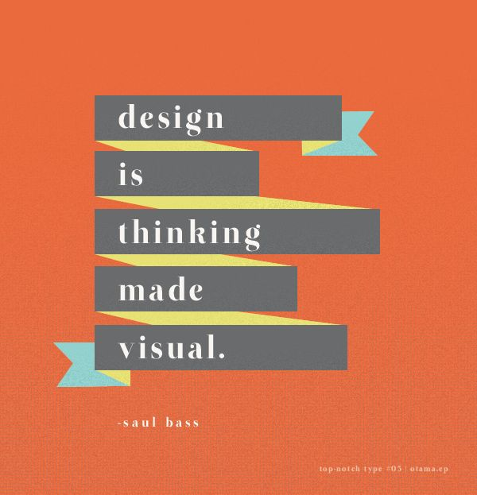
Project 3: Design
Design a saying or song lyric.
Use a background image
Style the typography
Pay attention to color choices
Use <span> and possibly <q>

Slide 19
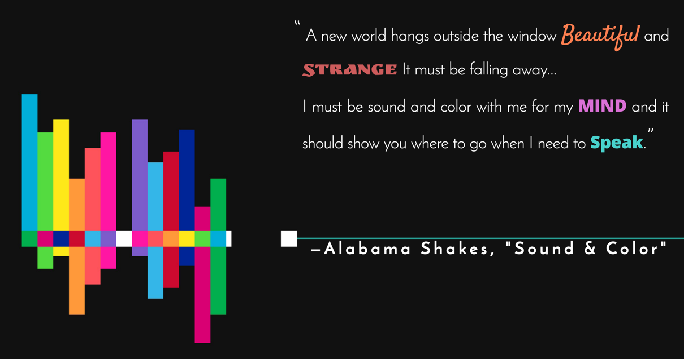
Project 3: Alicia Maxey S16

Slide 20
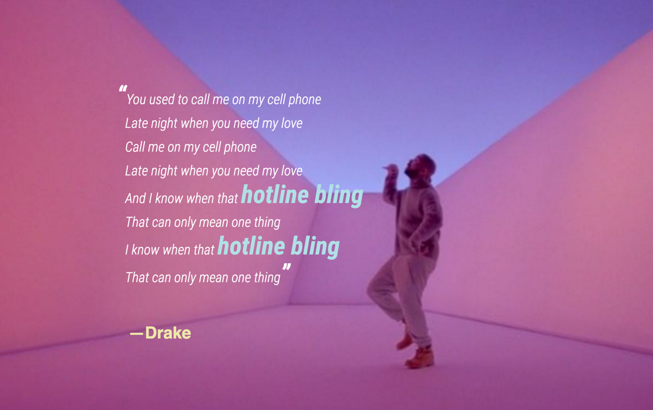
Project 3: Justin Muse S16

Slide 21
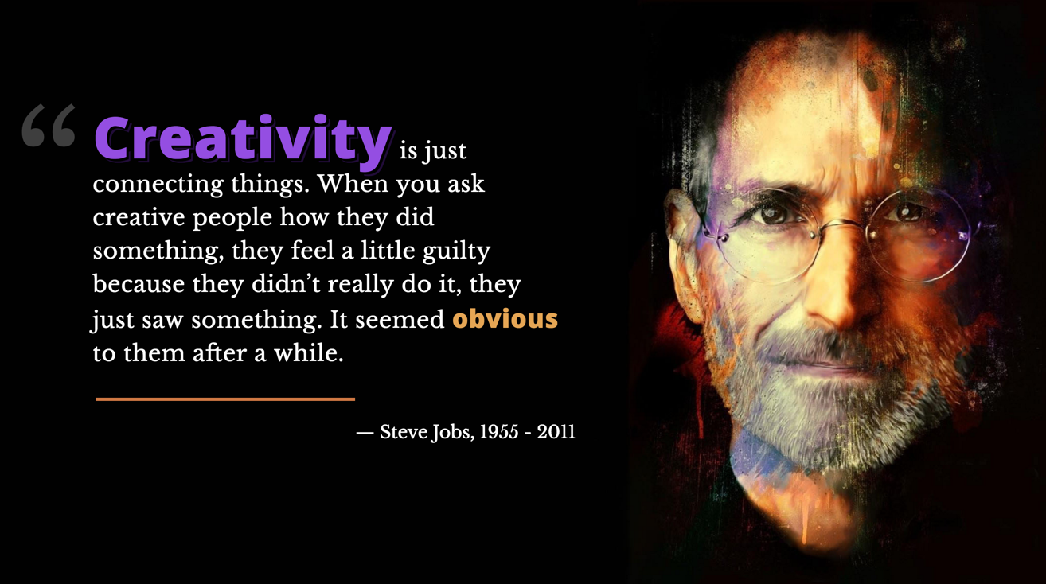
Project 3: Tyler Russell S16

